Slide 1
TITLE: SMART WASTE BIN MONITORING SYSTEM FOR EFFICIENT WASTE COLLECTION IN KIGALI
Presented by:
Names :IKIREZI Aneira Lavena
Reg No:25RP18074
Date: 30th September 2025

Slide 2
1. PROBLEM STATEMENT
Kigali’s current waste collection system faces significant challenges due to its reliance on fixed collection schedules and manual monitoring of waste bins. This often results in inefficiencies such as overflowing bins, missed collections, and underutilized collection resources. Overflowing waste bins contribute to environmental pollution, health hazards, unpleasant odors, and urban littering, negatively impacting the quality of life for residents.

Slide 3
Why this problem is important
Inefficient waste collection in Kigali leads to overflowing bins: Currently, waste is collected on fixed schedules (e.g., daily, weekly) instead of based on real-time bin fill levels
Environmental and health hazards from unmanaged waste: Bad odors from decomposing waste create an unhealthy environment for nearby communities
High operational costs due to reactive collection: Without predictive systems, waste management companies often use a reactive approach: trucks are dispatched only when complaints arise or when bins overflow.
Poor recycling rates from lack of urgency-based sorting: Valuable materials like plastics and metals often end up in landfills instead of recycling facilities

Slide 4
2.Dataset Description
Source: Provided dataset ("kigali_waste_dataset.csv")
Size: 2,000 samples, 8 features, 1 target
Features : weight,
material type,
district,
day,
weather,
bin capacity,
fill level
Weekend Indicator
Goal/Target: Collection Urgency (LOW, MEDIUM, HIGH, URGENT)

Slide 5
3. EDA (Exploratory Data Analysis)
Univariate Analysis
Bullet Points:- Fill level distribution shows most bins are over 70% full
Weight varies widely across districts
Material type skewed toward plastic and organic
Visuals: Include histograms and bar charts from your notebook.
Bivariate Analysis
Bullet Points:- Fill level vs. urgency shows strong positive correlation
Districts with higher urgency: Nyarugenge, Gasabo
Material type impacts urgency (organic waste more urgent)
Visuals: Box plots, scatter plots, and grouped bar charts.
Multivariate Analysis
Bullet Points:- Correlation matrix highlights fill level and weight as key predictors
Pair plots show interaction between district and material type
Weather and day have minor influence
Visuals: Heatmap and pair plot screenshots.

Slide 6
4. Feature Engineering
Outlier handling using IQR capping
Created new features: capacity utilization, weekend indicator
Encoding: Label encoding for urgency, one-hot for categorical
Scaling: StandardScaler for numerical features
Feature importance: Fill level, weight, capacity most important

Slide 7
5. Model building
Model Selection & Training
Bullet Points:
Models tested: - Random Forest
Logistic Regression
- Decision Tree
Best performer: Random Forest
- Accuracy: 85.
Model Evaluation
Bullet Points:
Precision, Recall, F1-score calculated for each class
Visuals: metric table.
Model deployment
Bullet Points:
Real-time prediction of collection urgency
User-friendly interface for waste management staff
Inputs: weight, fill level, material type, district, etc.
Output: urgency level + probability

Slide 8
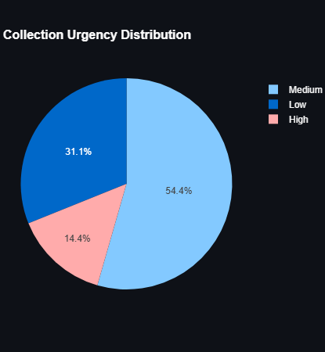
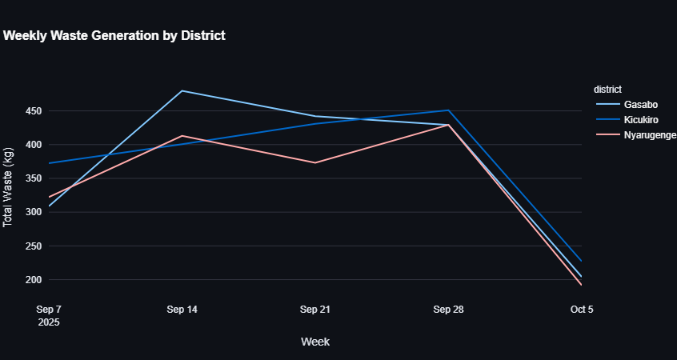
6. Screenshots

Slide 9
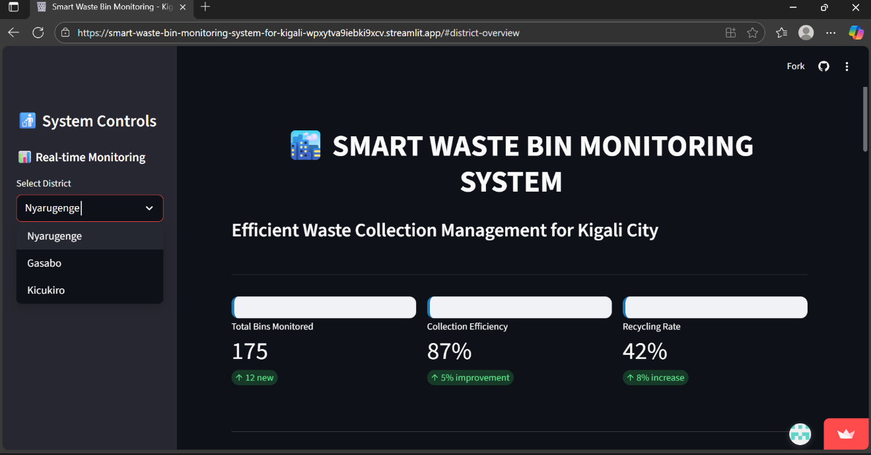
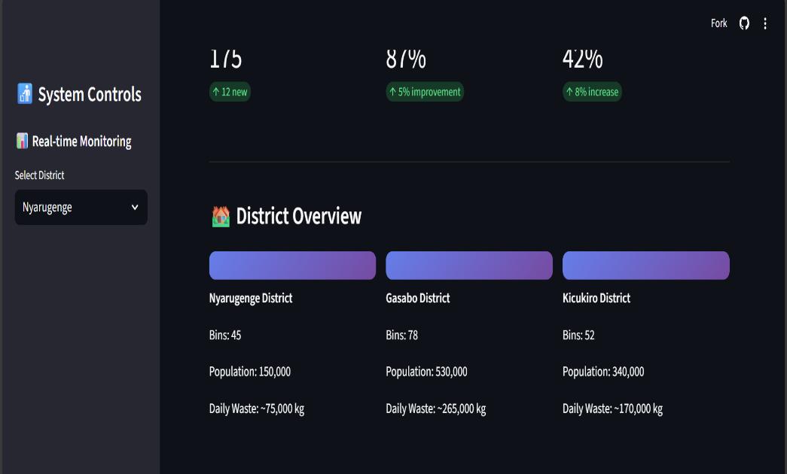
Screenshots

Slide 10
7. Links of streamlit and github
https://smart-waste-bin-monitoring-system-for-kigali-wpxytva9iebki9xcv.streamlit.app/
https://github.com/Lavena12/Smart-Waste-Bin-Monitoring-System-for-Kigali

